Slide 1








Object Detection
 | Result | Output Level | Instant Detect | All Areas Output | Models
Image Classification |  | Image | ✖ | 〇 | VGG ResNet Inception MobileNet DenseNet
Image Classification Localization |  | Box | ✖ | ✖ | HOG BOF PASCAL VOC
Object Detection |  | Box | 〇 | ✖ | R-CNN Fast R-CNN SDD YOLO RetinaNet
Semantic Segmentation |  | Pixel | ✖ | 〇 | U-NET MULTISCALE HYBRID CNN-CRF
Instant Segmentation |  | Pixel | 〇 | ✖ | Mask R-CNN DeepMask FCIS
Panoptic Segmentation |  | Pixel | 〇 | 〇 | Panoptic Feature Pyramid Network UPSNet
Dog 98%
Dog 93%
Dog 93%
Dog 97%
https://jingwora.github.io/

Slide 2



Slide 3



















PYSPARK
SKLEARN

Slide 4



Slide 5




Slide 6
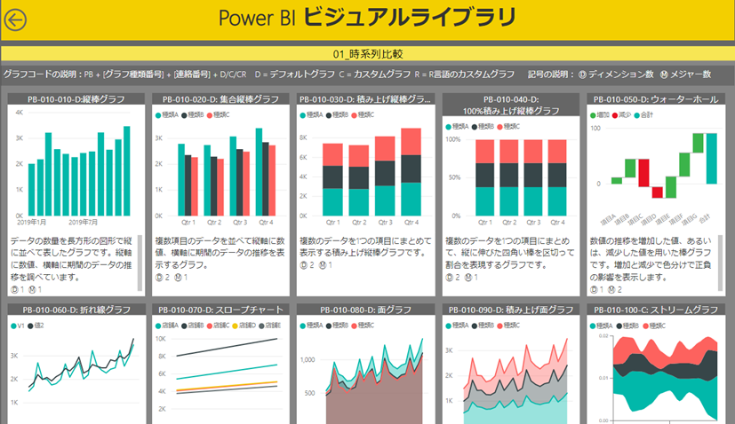
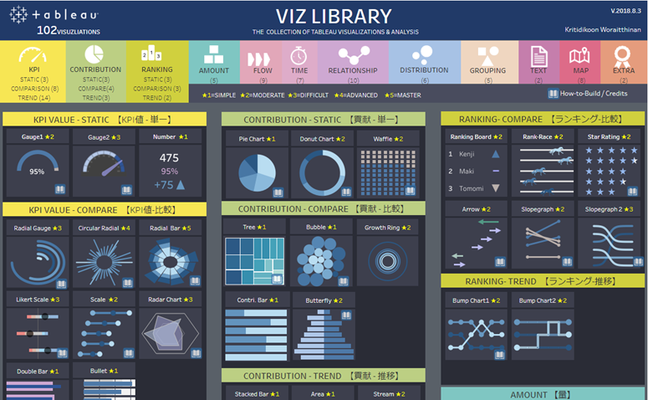
https://community.powerbi.com/t5/Data-Stories-Gallery/PowerBI-Visual-Library/td-p/998398

Slide 7





Slide 8














ENVIRONMENT
DEV
SERVER
USER
VS CODE
Tensorflow.js
Colab
Tensorflow.js
Tensorflow.js
Local + Cloud
GitHub Pages: static site
AI at the Edge

Slide 9


Slide 10


Slide 11





Data Analysis
Data Science
Data Engineer
Web Developer
Cloud Engineer

Slide 12
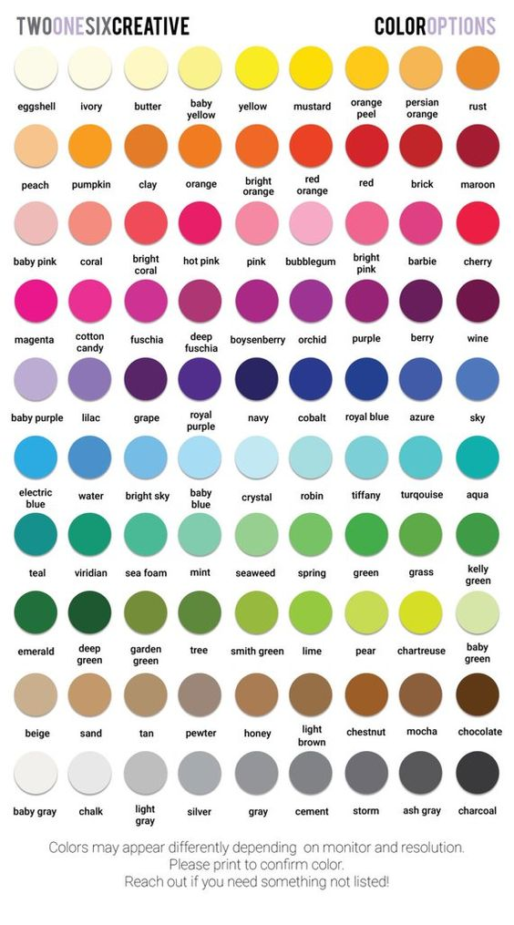
Total quality management (TQM)
4M Analysis Process
4M
 | Machine | Material | Man | Method
Plan
Actual
QA Status
 | Checking | Checked | Status | IQ
Line1
Line2
Line3
Line4
PPM
PPM
Claim
Defect

Slide 13


CONCEPTUAL MOCKUP
PRODUCTION REPORT
PRODUCTION LINE STATUS 製造ライン状況
● LIVE
COUNTRY 国 |  | REGION 地域 |  | FACTORY 工場 |  | BUILDING ビル
Japan | ▼ | Kantou | ▼ | JF001 | ▼ | B001 | ▼
OPRATION TIME 活動時間
(Actual vs Plan)
STOP TIME 停止期間
(Actual vs Plan)
BREAK TIME 休憩時間
(Actual vs Plan)
CURREN TIMELINE
現在タイムライン
(Actual vs Plan)
8,250
(85%)
350
(120%)
920
(95%)
78%
Line No. | Operation Timeline タイムライン |  |  |  |  |  |  |  |  |  |  |  |  |  |  |  |  |  |  |  |  |  |  |  | Current Status | Stop Time (minute) |  | ▲
LX101 |  |  |  |  |  |  |  |  |  |  |  |  |  |  |  |  |  |  |  |  |  |  |  |  | OP | 30 | ℹ
LD220 |  |  |  |  |  |  |  |  |  |  |  |  |  |  |  |  |  |  |  |  |  |  |  |  | BK | 0 | ℹ
LL201 |  |  |  |  |  |  |  |  |  |  |  |  |  |  |  |  |  |  |  |  |  |  |  |  | ST | 320 | ℹ
LX201 |  |  |  |  |  |  |  |  |  |  |  |  |  |  |  |  |  |  |  |  |  |  |  |  | OP | 0 | ℹ
LB301 |  |  |  |  |  |  |  |  |  |  |  |  |  |  |  |  |  |  |  |  |  |  |  |  | OP | 0 | ℹ
7:00 | 9:00 |  |  |  | 11:00 |  |  |  | 13:00 |  |  |  | 15:00 |  |  |  | 17:00 |  |  |  | 19:00 |  |  |  |  |  |  | ▼
Line: LL201
Period: 14:00 – 17:00
Controller: John Walker
Memo: Machine Repair
ℹ get Details
Operation Status: ● Stop(ST) ● Break(BK) ● Operate(OP) ● Inactive(IA)
https://jingwora.github.io/

Slide 14
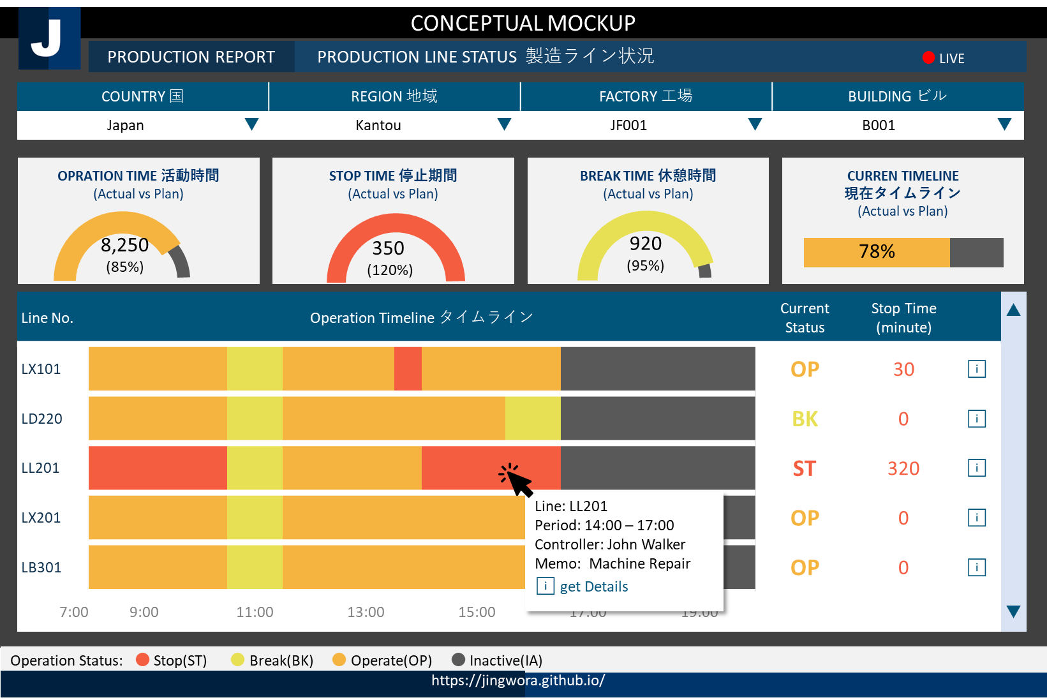






ENVIRONMENT ARCHETECTURE
DEV
OPS
USER
SSMS
Power BI
ARM
Template
Blob
Storage
Data
Factory
SQL
Server
Power BI
Local + Cloud
Cloud
Live

Slide 15
CONCEPTUAL MOCKUP
FINANCIAL ANALYSIS REPORT 財務分析レポート
Region 地域
EU | ▼
Income Statement | Balance Sheet | Cash Flow | Financial Ratio | Root Cause | Simulation
 | 2018 |  | 2019 |  | 2020 YTD
 | Actual | Vs Budget | Actual | Vs Budget | Actual | Vs Budget
⊞ Net product sales | 79,000 | +200 | 82,000 | +200 | 101,000 | +200
⊞ Net service sales | 27,000 | -100 | 31,000 | -100 | 27,000 | -100
Total net sales | 96,000 | +100 | 113,000 | +100 | 127,000 | +100
⊟ Operating expense
Cost of sales | 71,000 | +400 | 61,000 | +400 | 81,000 | +400
Fulfillment | 13,000 | -200 | 15,000 | -200 | 19,000 | -200
Marketing | 5,000 | +300 | 4,000 | +300 | 4,000 | +300
Other operating expense | 500 | +10 | 600 | +10 | 500 | +10
Total operating expense | 88,500 | +400 | 78,500 | +400 | 94,500 | +400
⊞ Operating income | 2,500 | +200 | 3,500 | +200 | 4,400 | +200
⊞ Interest expense | (150) | -10 | (150) | -10 | (200) | -10
⊞ Other income | 100 | +50 | 100 | +50 | 100 | +50
Income before income taxes | 2,450 | +60 | 3,650 | +60 | 3,450 | +60
Provision for income taxes | (450) | -20 | (550) | -20 | (500) | -20
Net income | 2,000 | +50 | 3,100 | +50 | 2,800 | +50
Country 国
Germany | ▼
Branch 支店
Munich G01 | ▼
Fiscal Year 年度
FY2020 | ▼
Year | Quarter
EN | 日本 | 中国
Drill-Through
to get
more insights
ℹ get Details
Unit 通貨
Million | ▼
Drill Down
Currency 通貨
Yen | ▼
https://jingwora.github.io/

Slide 16
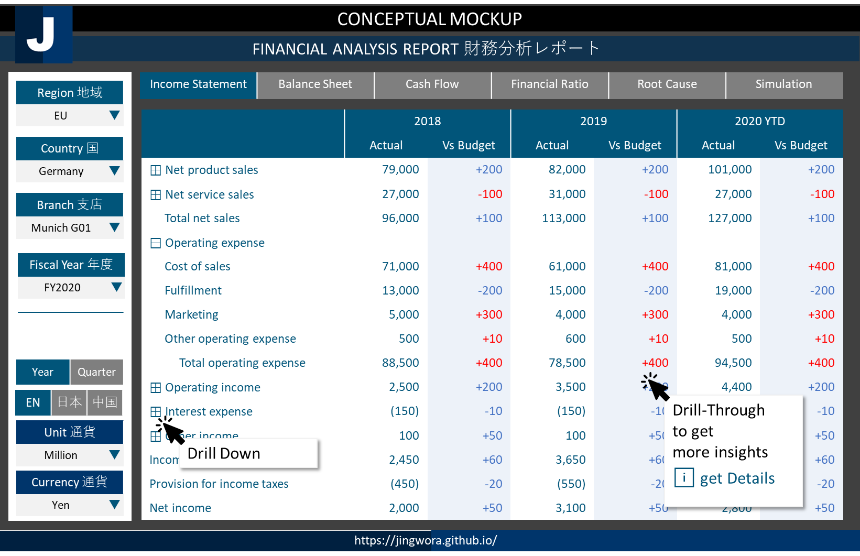

ENVIRONMENT ARCHETECTURE
DEV
OPS
USER
SSMS
Power BI
Blob
Storage
Data
Factory
SSAS
SQL
Server
Power BI
Local + Cloud
Cloud
RFM Parameter

Slide 17
CONCEPTUAL MOCKUP
CUSTOMER TRANSACTION ANALYSIS 顧客のトランザクション分析
Period 期間
2020 | ▼
RFM | Sales Decomposition | Market Basket | Churn Analysis | Promotion Effectiveness | Customer Journey
RFM (No. of members) (vs LY)
 |  |  | ◀ | R1 | R2 | R3 | R4 | ▶
 | ▲
 | F4 |  | 15 +1 | 1,100 +10 | 500 -20 | 250 +20 | 12 +5
 | F3 |  | 110 -10 | 350 -10 | 320 +15 | 250 +5 | 41 +20
 | F2 |  | 207 +15 | 750 -100 | 550 +30 | 221 +15 | 315 +10
 | F1 |  | 310 -55 | 210 -20 | 130 -10 | 114 -10 | 312 -10
 | ▼
■ Platinum ■ Gold ■ Silver ■ Bronze ■ Churn
Profiles プロフィール
Area アリア
Kantou | ▼
Age
Male
38%
Branch 支店
Munich G01 | ▼
70%
60%
50%
30%
Female
62%
20’s 30’s 40’s 50’s
Recency 最終購入日
R1 | R2 | R3 | R4
1 | 2 | 3 | 4
Behavior 行動 (Product Contribution)
Frequency
Editable
Product1
Product2
Frequency 購入回数
F1 | F2 | F3 | F4
2 | 4 | 6 | 8
Product3
Get full list
For target marketing
ℹ get Details
Product4
Monetary 購入金額
M1 | M2 | M3 | M4
30 | 40 | 50 | 60
Value
https://jingwora.github.io/

Slide 18
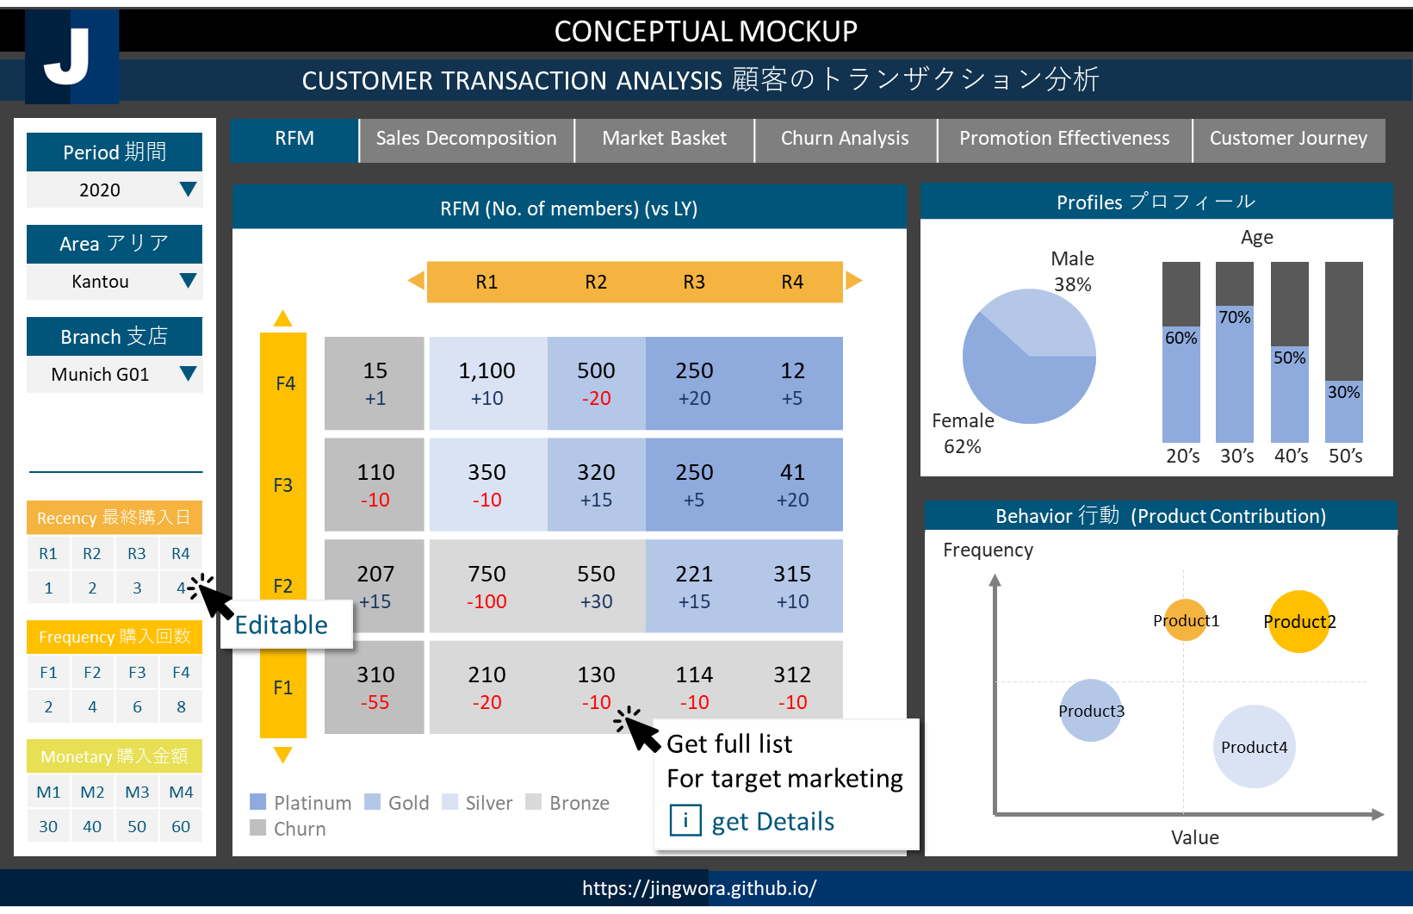

ENVIRONMENT ARCHETECTURE
DEV
OPS
USER
SSMS
Power BI
Blob
Storage
Data
Factory
SSAS
SQL
Server
Power BI
DAX
Language
Local + Cloud
Cloud
RFM Parameter

Slide 19
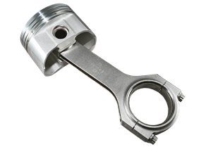
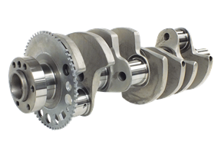
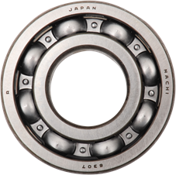
CONCEPTUAL MOCKUP
Material Management - Bill of Material (BOM)
Factory 工場
Factory 1 | ▼
BOM | Inventory Management | Order Status Analysis | Production Planning | Production Planning | Cost Structure Simulation
Part No. | Description | Type | Quantity | Cost | Status | ▲
⊟ EN-101 | Assembly 1 | Assembly | 1 | 105 | Active
PX-101 | Parts 1 | Parts | 2 | 5 | Active
PX-102 | Parts 2 | Parts | 1 | 5 | Active
PX-103 | Parts 3 | Parts | 1 | 80 | Active
⊟ EN-102 | Assembly 2 | Assembly | 1 | 55 | Active
PX-104 | Pats 5 | Pats | 1 | 25 | Active
PX-105 | Parts 6 | Parts | 3 | 10 | Active
⊟ EN-103 | Assembly 2 | Assembly | 1 | 35 | Active
PX-106 | Parts 8 | Parts | 1 | 10 | Active
PX-107 | Parts 9 | Parts | 1 | 1 | Active | ▼
Detail Part No. EN-101
Department 部門
Department 1 | ▼
Catalog No. カタログNo.
ALL | ▼
Part No. パーツNo.
ALL | ▼
Description Gear Set EX | ▲
Dimension: 30*280*30
Weight: 1.5kg
Manufacturer: Toyo Group
Lead time: 15 days
 | ▼
BOM Structure
⊟ Product Group 1 | ▲
⊟ Product 1
■ Assembly 1
■ Assembly 2
□ Assembly 3
□ Assembly 4
□ Assembly 5
⊞ Product 2
⊞ Product 3
⊞ Product Group 2 | ▼
PX-101
PX-102
PX-103
EN-101
FXN-501
https://jingwora.github.io/

Slide 20
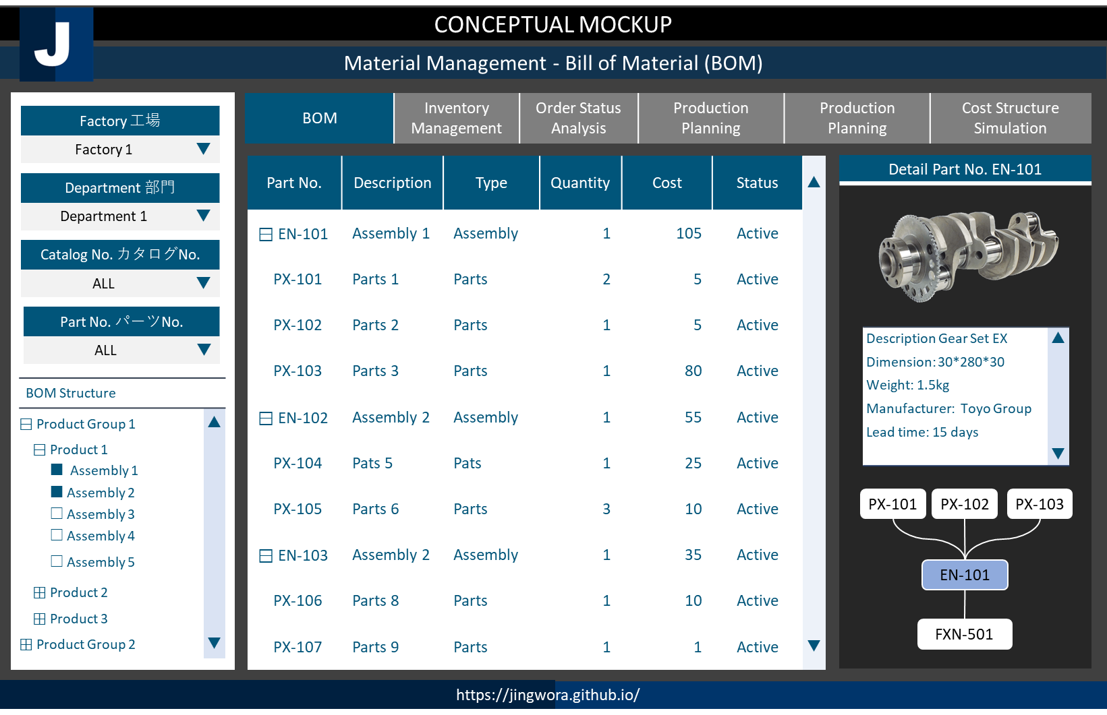
ENVIRONMENT ARCHETECTURE
DEV
OPS
USER
SQL
Workbench
Tableau
My SQL DB
Tableau
Local
On-prem
Visualization

Slide 21
CONCEPTUAL MOCKUP
CUSTOMER SERVICE ANALYSIS 顧客満足度分析
Customer Journey | NPS 顧客満足度
PROSPECT
PURCHASE
USE
AFTER USE
Call Center
Call Center
TV Ads
Service Center
Store
Website
APP
E-mail
Landing Page
APP
LINE
Call Center
Website
YouTube
APP
APP
Twitter
Chatbot
Facebook
https://jingwora.github.io/

Slide 22
CONCEPTUAL MOCKUP
SUPPLY CHAIN MANAGEMENT サプライチェーン・マネジメント
Supply Chain Status |  | SIMULATION |  | BOM
https://jingwora.github.io/

Slide 23
CONCEPTUAL MOCKUP
SUPPLY CHAIN MANAGEMENT サプライチェーン・マネジメント
Supply Chain Status |  | SIMULATION |  | BOM
https://jingwora.github.io/

